Slide 1


Digital Amplification Plan
For Snatch

Slide 2
Define Objective & Flow
Objective of the activity :-
Create the Buzz and excitement around the Snatch .
Creating the over all experiential promotion activity.
Reaching target audiences in the right place and time
Creating a community of loyal and engaged users
Brand building around an app
Increasing mobile app visibility and downloads

Slide 3
3 Phase Content Strategy
Long term engagement
Retargeting
Viral Advertisement
Outreach
Media Coverage
Blog
Research
AOC
Before the launch
Launch
(Burst campaign)
After launch

Slide 4
Phase 1 Before Launch :- Target geography
INDIA
1.30 billion population
400 million smart phone user
50 % of population under 25 year
200+ million broadband subscriber
Average data consumption more that 2 GB per month
At least 97 per cent of smartphone users in India use communication apps every day, with WhatsApp being the app of choice for 96 per cent of them .

Slide 5
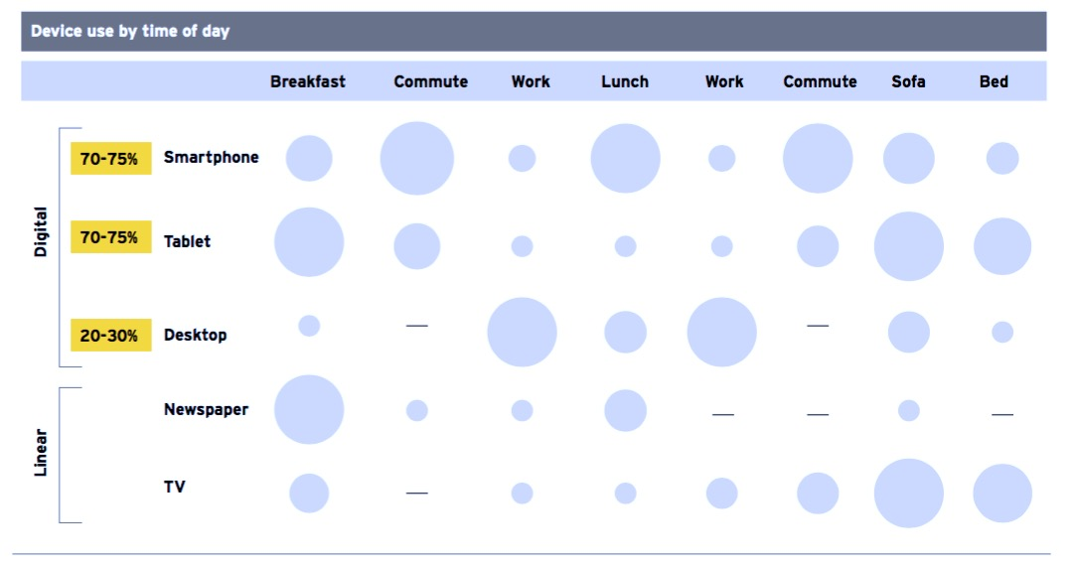
Phase 1 Before Launch :- Omni platform content consumption in India

Slide 6
Phase 1 Before Launch :- App store optimization (ASO)
An apps’ title, screenshots, description and included keywords make a huge impact on whether or not it gets discovered among app store search engines.
Optimizing for this is thus incredibly important.
Extra tips on impactful ASO tactics :
Concentrate on long-tail keywords
Don’t stuff app descriptions and titles with too many keywords (3-4 is enough)
Provide screenshots that will show main app features .
By optimizing in-app content, you increase your chances of ranking higher within app stores where users are browsing for new content to download.
Duration of Activity :- 3 months

Slide 7
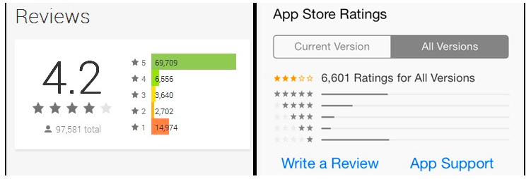
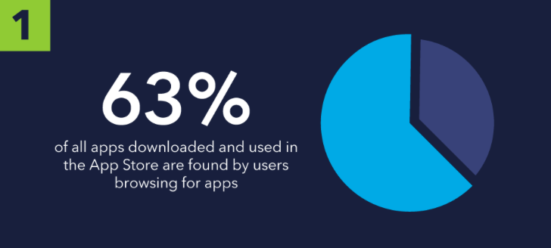
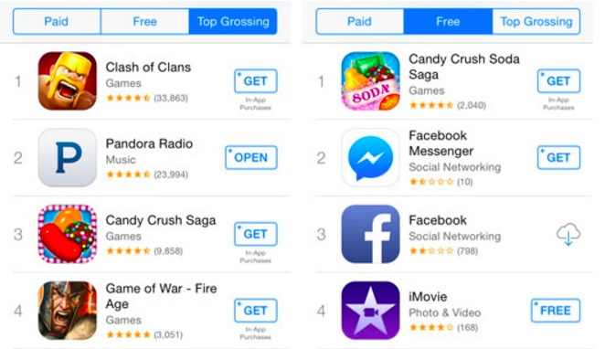
Phase 1 Before Launch :- Budget
One dedicated resource
Duration of Activity :- 3 months
Activity
Title
Key words
Rating and Review
App SEO
Description
Investment :- INR 1,10,000 per month ( 3 to 6 month activity ) .

Slide 8
Phase 1 Before Launch :- Content Calendar
An editorial calendar is the easiest way to plan ahead when executing your content strategy as it will help you map out posts on a consistent basis for maximum exposure.
We create an editorial calendar a few months in advance, defining main publication topics and seasonal posts, while leaving space for industry news and trends updates.
Blog
Article
Interview
Guest Post
Planning content a month or two in advance will leave enough time for:
Proper research of a particular topic
Creating some buzz across digital platforms and in the community
Updates and other marketing activities
Localization on new markets can be synced with local media coverage and announcement posts
Preparing case studies about app successes

Slide 9
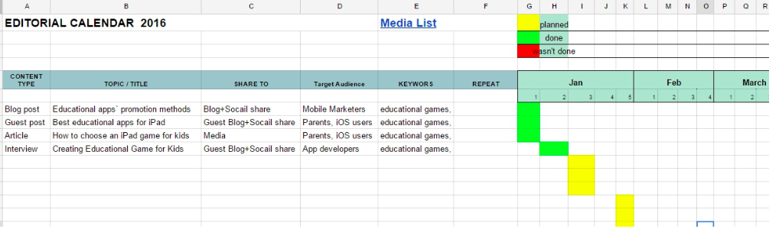
Phase 1 Costing :- Content Calendar
Sample Content calendar
Blog :- INR 1,75,000 (30 blog )
Article :- INR 1,55,000 (50 Blog)
Guest Post :- INR 65000 (10 post )

Slide 10
Phase 2 Launch Phase :- Influencer marketing
An app launch is the best time for getting exposure on industry blogs and media channels.
Just as burst campaigns help to acquire critical user growth for a new app, media exposure can put an app on the map and increase the number of organic downloads over time.
Try to leverage significant audiences by getting your app reviewed by those who matter the most in the industry.
Influencer Marketing Plan :-
50 bloggers
1 Blog post from each blogger
Expected Impact :-
50 million plus impression , 4000 plus conversation , 15k plus blog view

Slide 11
Phase 2 Costing :- Influencer marketing
Influencer Marketing Plan :-
50 bloggers
1 Blog post from each blogger
Sample bloggers list
http://appstimes.in
http://www.computergeekblog.com
http://www.fonearena.com/blog/
https://www.appfutura.com/blog/tag/india/
https://www.appsquadz.com/blog/category/mobile-app-development/
Costing :- INR 40,000 per blog
Total costing :-- INR 9,00,000
Duration :- 3 month

Slide 12
Phase 2 Launch Phase :- Influencer marketing Model
Identify
Segment
Activate
Monitor & Optimize
Influencers can create
/ share 3 kinds of content:
Influencers are the most credible and authentic sources of advocacy for brands.
Contextual fitment plays a key role in identifying the right influencers for reaching the right audience.
Context is defined by objectives that need to be met - awareness, engagement, eliciting response, endorsement – and also by the timing and geography.
Influencers are segmented basis genres and the credibility they enjoy among audiences.
Branded content: Resting on the brand’s digital platforms
Co-created content: Created by influencers within the guidelines defined by the brand
Influencer generated content: Content without many guidelines, thus appearing authentic & credible.
But communication cannot be one-way and needs to be tweaked in-line with what people are saying – either proactively or as a result of what Zivame influencer outreach.
Once segmented, the communication framework can be drafted in line with the objectives and in the desired format and platform.

Slide 13
Phase 2 Launch Phase :- Viral marketing
Most of us know that you can increase content outreach tenfold by producing something that gets shared. This kind of word of mouth marketing is more effective than outdated and untrusted methods of direct advertising.
By adding some shareable elements to your content, you can incentivize people to spread the word about your app to their family, friends, peers and even followers online.
Some well-tested components of viral content:
Storypick
Scopwhoop
Digit
Timesinternet
The quint
Ndtv Gadget
They all have average web page traffic of more than 2million plus and they are highly popular among the youth .

Slide 14
Phase 2 Costing :- Viral marketing
Storypick :- http://www.storypick.com
Scopwhoop :- https://www.scoopwhoop.com
Digit :- http://www.digit.in
Timesinternet :- http://timesinternet.in
The quint :- https://thequint.com
Ndtv Gadget :- http://gadgets.ndtv.com
Lifewire :- www.lifewire.com
Costing :- INR 3,90,000 per native article
Number of digital viral sites :- 4

Slide 15
Phase 3 After Launch Phase :- Long term Engagement
Blogging and Twitter engagement
Engaging bloggers from Technology , Lifestyle and Fashion for multiple engagement .
Engaging Twitter Influencer for on going engagement .
Bloggers will review the product and create the blogs as per the brief .
Video Blogging
Video Blogger will Review the product on their respective channel .
Create more awareness about the product in various different communities and forums .

Slide 16
Phase 3 Costing :- Long term Engagement
Blogging and Twitter engagement
Engaging bloggers from Technology , Lifestyle and Fashion for multiple engagement .
Engaging Twitter Influencer for on going engagement .
Bloggers will review the product and create the blogs as per the brief .
Number :- 50 bloggers , 5000 tweet
costing :- INR 8,00,000
Video Blogging
Video Blogger will Review the product on their respective channel .
Create more awareness about the product in various different communities and forums .
Number of Video Blog :- 5
costing :- INR 3,50,000

Slide 17
Thanks !!!!

